Slide 1





Understanding Career Aspirations of Gen Z
Laxmi Soundarya Pothineni

Slide 2




Roadmap
1
Problem Statement
2
Data Collection
3
Cleaning in Excel
Developed a problem statement to explore and educate about the career aspirations of Gen-Z, addressing challenges and personal insights.
Created a Google Form with tailored questions to collect data on Gen-Z's career aspirations
Loaded data dump into Excel , cleaning and exploring high level information using Power Query and Excel tools.
Collaborative Process
6
Focused Power-BI dashboard
5
General Excel dashboard
4
Analyzing in SQL
Developed three focused dashboards for each area, incorporating KPIs, Power Query Editor, measures, and groups in Power BI.
Created a Excel dashboard summarizing Gen-Z's learning aspirations, mission aspirations, and manager aspirations
Conducted data analysis using SQL, solving complex questions with the help of Common Table Expressions (CTEs) and joins.

Slide 3

Stage 1: Problem Statement

Slide 4
What
What are the primary career goals of Gen Z?
Gen Z prioritizes financial stability, work-life balance, and social impact. They seek careers that align with their values and passions.
What skills and qualifications do Gen Z prioritize in their career paths?
Technical skills, soft skills like communication and problem-solving, and certifications are highly valued. They also seek opportunities for continuous learning and development.
What are the top companies or organizations that Gen Z aspires to work for?
Tech giants like Google, Apple, and Microsoft, as well as innovative startups and social impact organizations, are top choices.
What are the key factors that influence Gen Z's career decisions?
Salary, benefits, company culture, work-life balance, and opportunities for growth and development are major factors. Gen Z also considers a company's social responsibility and ethical practices.

Slide 5
When
When do Gen Z typically start considering their career paths?
Many Gen Z individuals start thinking about their career paths during high school, influenced by academic interests and extracurricular activities.
When do Gen Z expect to achieve their short-term and long-term career goals?
Short-term goals, like securing a stable job, might be within the first 5 years. Long-term goals, such as career advancement or starting a business, could be 10 years or more.
When do employers typically start recruiting Gen Z for entry-level positions
Employers often start recruiting Gen Z during college recruitment drives or through internships.
When do Gen Z expect to see significant career advancements?
Gen Z is ambitious and expects rapid career progression. They may aim for promotions or new roles within 5 years of starting their careers.

Slide 6
Where
Where do Gen Z seek information and advice about career paths?
Gen Z relies heavily on online platforms, social media, and career counseling services. They often consult with mentors and peers for guidance.
Where do Gen Z prefer to work?
While many Gen Z individuals prefer traditional office settings, they are open to remote work and hybrid models.
Where do employers typically recruit Gen Z talent?
College campuses, online job boards, and social media platforms are common recruitment channels for Gen Z.
Where do Gen Z see themselves working in the future?
Gen Z is increasingly global-minded and open to working internationally. They may consider opportunities in various countries and cultures.

Slide 7
Who
Who are the key influencers shaping Gen Z's career aspirations?
Parents, teachers, peers, and social media influencers play significant roles in shaping Gen Z's career aspirations.
Who are the employers actively recruiting Gen Z talent?
Tech companies, consulting firms, and startups are actively recruiting Gen Z talent
Who are the mentors and role models that Gen Z admires in their chosen careers?
Successful entrepreneurs, industry leaders, and social activists are often admired by Gen Z.
Who is the key decision-makers in Gen Z's career journeys?
Gen Z is increasingly taking ownership of their career decisions, but they still value input from parents, mentors, and career counsellors.

Slide 8
Why
Why are certain industries or sectors more attractive to Gen Z than others?
Industries that offer innovation, social impact, and opportunities for creativity are particularly appealing to Gen Z.
Why do employers value Gen Z's unique skills and perspectives?
Gen Z is tech-savvy, digitally native, and adaptable. They bring fresh perspectives and innovative ideas to the workplace.
Why do Gen Z prioritize certain values and beliefs in their career choices?
Gen Z prioritizes work-life balance, social responsibility, and ethical business practices. They seek careers that align with their values.
Why do Gen Z seek work-life balance and flexibility in their careers?
Gen Z values their personal well-being and seeks flexible work arrangements to balance their professional and personal lives.

Slide 9
How
How can employers effectively attract and retain Gen Z talent?
Gen Z prioritizes financial stability, work-life balance, and social impact. They seek careers that align with their values and passions.
How can educational institutions prepare Gen Z for the future of work?
Educational institutions can prepare Gen Z for the future of work by offering relevant curriculum, internships, co-op programs, and career counseling services.
How can Gen Z leverage technology to advance their careers?
Gen Z can leverage technology to network, build their personal brands, and acquire new skills through online learning platforms.
How can Gen Z develop the necessary skills and competencies to succeed in the workplace?
Gen Z can develop the necessary skills and competencies through continuous learning, mentorship, and professional development programs.

Slide 10
Conclusion
By understanding Gen Z's priorities, values, and expectations, organizations can attract and retain top talent. Key factors include work-life balance, social impact, continuous learning, and a positive work culture.

Slide 11
Stage 2: Data Collection

Slide 12
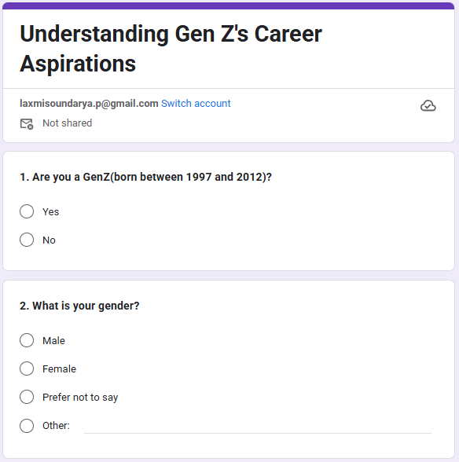
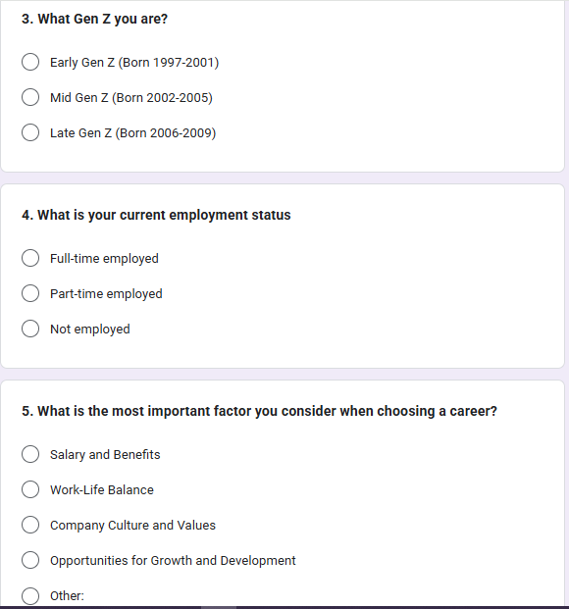
Survey Questionnaire

Slide 13
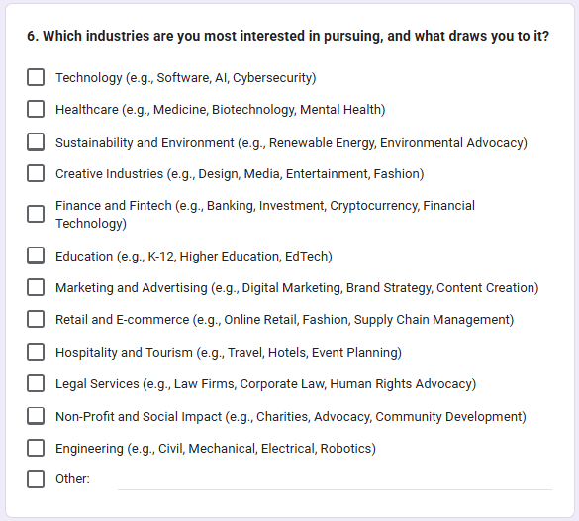
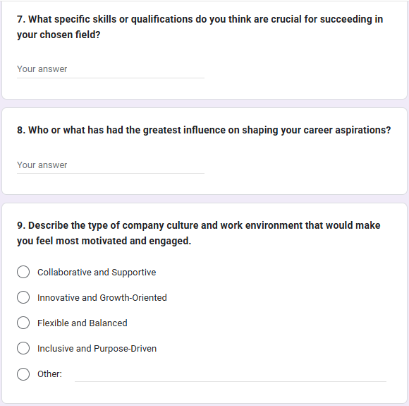

Slide 14
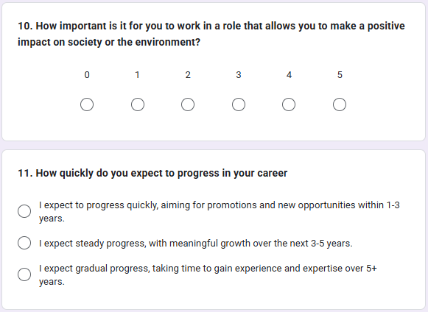
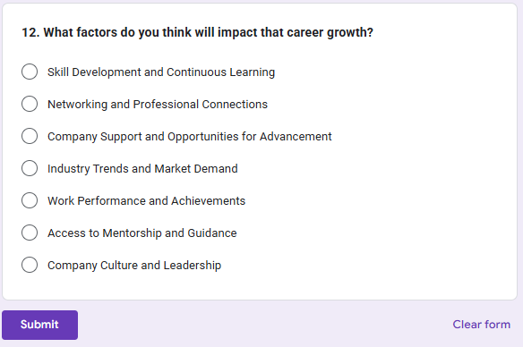

Slide 15
Stage 3: Cleaning & Standardizing in Excel

Slide 16
1. Remove Duplicates
Select your data range.
Go to Data → Remove Duplicates.
Choose columns that should be unique and press OK.
2. Trim Extra Spaces
Use =TRIM(A1) to remove leading, trailing, and extra spaces between words.
3. Convert Text Case (Upper/Lower/Proper)
Uppercase: =UPPER(A1)
Lowercase: =LOWER(A1)
Proper case (capitalize first letter): =PROPER(A1)
4. Fix Inconsistent Data Formatting
Convert numbers stored as text: Select column → Click "!" icon → Convert to Number.
Standardize date formats: Use TEXT function (=TEXT(A1, "YYYY-MM-DD")).
5. Find & Replace Errors
Use CTRL + H (Find and Replace) to fix common misspellings or unwanted characters.
Replace blank cells with =IF(A1="", "N/A", A1)

Slide 17
6. Remove Non-Printable & Special Characters
Use =CLEAN(A1) to remove line breaks and non-printable characters.
Remove unwanted characters: =SUBSTITUTE(A1, "-", "") (modify as needed).
7. Standardize Data Formats
Numbers: Format as Currency, Percentage, or Decimal using the Format Cells option.
Dates: Use YYYY-MM-DD or another consistent format.
8. Split & Merge Data
Split: Use Text to Columns (under Data tab) to separate full names, addresses, etc.
Merge: Use =CONCATENATE(A1, " ", B1) or =TEXTJOIN(" ", TRUE, A1, B1).
9. Use Data Validation
Go to Data → Data Validation to restrict input (e.g., allow only dates or predefined categories).
10. Handle Missing Data
Fill missing values with =IF(A1="", "Unknown", A1).
Use Go To Special → Blanks to highlight empty cells.

Slide 18
Stage 4: Analyzing in SQL

Slide 19
1. What industries are Gen-Z most interested in pursuing careers in?
SELECT
Preferred_Aspirational_Job,
COUNT(Preferred_Aspirational_Job) AS Respondents
FROM Gen-Z
GROUP BY Preferred_Aspirational_Job
ORDER BY Respondents DESC
LIMIT 3;
2 What are the top factors influencing Gen-Z’s career choices?
SELECT
Influencing_Factors,
COUNT(Influencing_Factors) AS Respondents
FROM Gen-Z
GROUP BY Influencing_Factors
ORDER BY Respondents DESC
LIMIT 3;

Slide 20
3. What is the desired work environment for Gen-Z? (e.g., remote, hybrid, in-office)
SELECT
Preferred_Work_Environment,
COUNT(Preferred_Work_Environment) AS Respondents
FROM Gen-Z
GROUP BY Preferred_Work_Environment
ORDER BY Respondents DESC
LIMIT 1;
4. How do financial goals, such as salary and benefits, impact career aspirations among Gen-Z?
SELECT
Preferred_Aspirational_Job,
AVG([For the First 3 years of your career, what is your minimum expected monthly salary in Hand?]) AS Avg_Salary_First_3_Years,
AVG([After 5 years of your career from now, what is your minimum expected monthly salary in Hand?]) AS Avg_Salary_After_5_Years,
AVG([What is your minimum expectations of salary when you are starting your career (Monthly in hand salary)]) AS Avg_Salary_Starting,
COUNT(*) AS Respondents
FROM GenZ

Slide 21
WHERE [For the First 3 years of your career, what is your minimum expected monthly salary in Hand?] IS NOT NULL
AND [After 5 years of your career from now, what is your minimum expected monthly salary in Hand?] IS NOT NULL
AND [What is your minimum expectations of salary when you are starting your career (Monthly in hand salary)] IS NOT NULL
GROUP BY Preferred_Aspirational_Job
ORDER BY Avg_Salary_Starting DESC;
5. What role do personal values and social impact play in career choices for Gen-Z?
SELECT
Preferred_Aspirational_Job,
COUNT(*) AS Respondents,
AVG(CASE WHEN [Work for Company with Undefined Mission] = 'Yes' THEN 1 ELSE 0 END) AS Percent_Work_Company_Undefined_Mission,
AVG(CASE WHEN [Work for Company with Misaligned Mission?] = 'Yes' THEN 1 ELSE 0 END) AS Percent_Work_Company_Misaligned_Mission,
AVG(CASE WHEN [Likeliness to work for company with no social impact] = 'Yes' THEN 1 ELSE 0 END) AS

Slide 22
Percent_Work_No_Social_Impact,
AVG(CASE WHEN [Would you work for a company that has NO-REMOTE working policy] = 'Yes' THEN 1 ELSE 0 END) AS Percent_Work_No_Remote,
AVG(CASE WHEN [Would you work for a company that has Laid-Off Employees recently?] = 'Yes' THEN 1 ELSE 0 END) AS Percent_Work_LaidOff_Employees
FROM GenZ
WHERE [Work for Company with Undefined Mission] IS NOT NULL
AND [Work for Company with Misaligned Mission?] IS NOT NULL
AND [Likeliness to work for company with no social impact] IS NOT NULL
AND [Preferred_Aspirational_Job] IS NOT NULL
GROUP BY Preferred_Aspirational_Job
ORDER BY Respondents DESC;

Slide 23
Stage 5: General Excel Dashboard

Slide 24
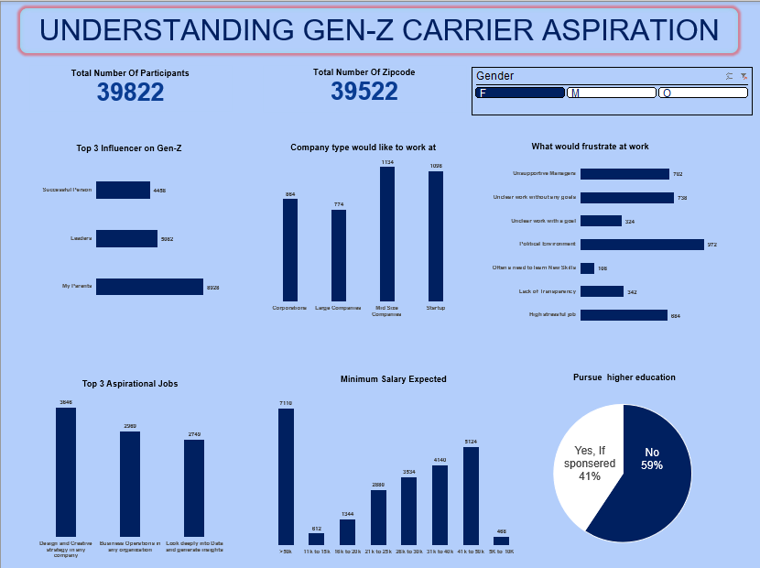

Slide 25
Stage 6: Focus Area Driven Power BI Dashboard

Slide 26
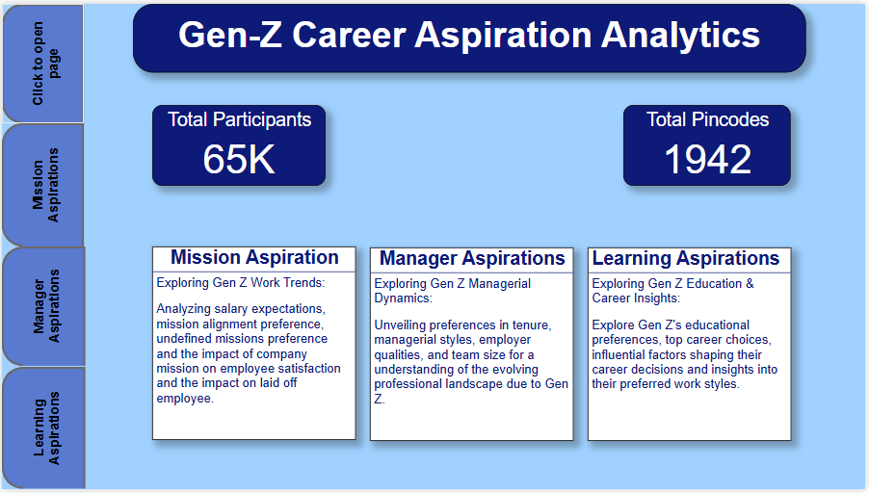

Slide 27
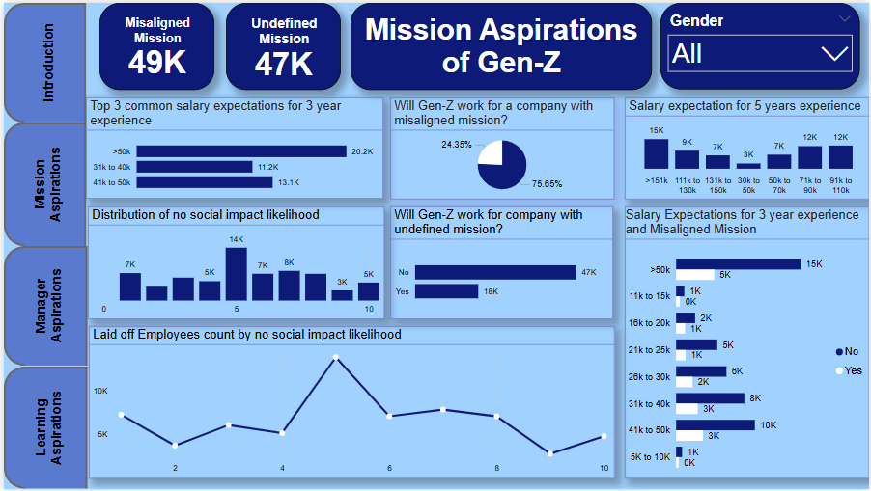

Slide 28
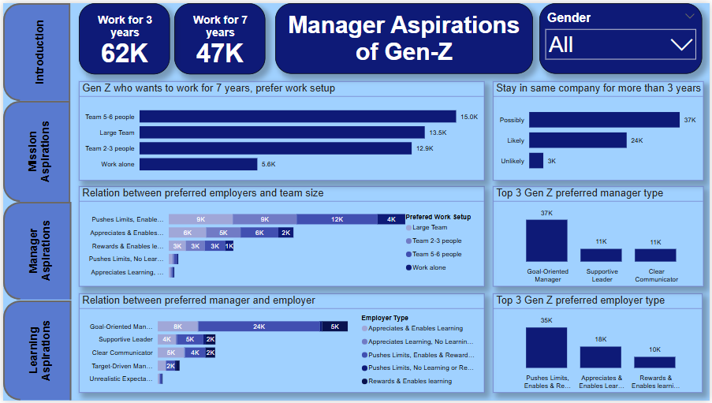

Slide 29
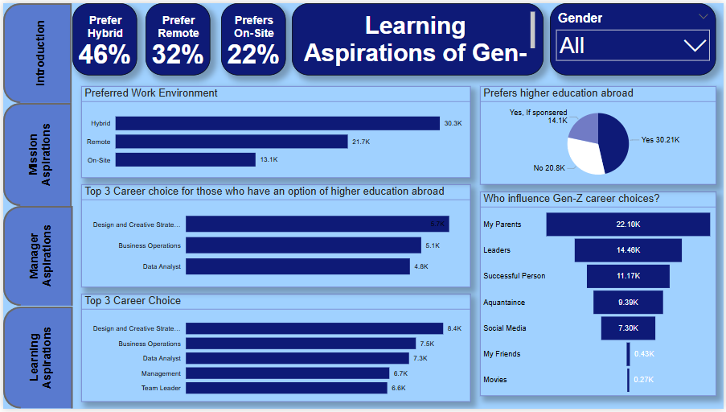

Slide 30
Thank You

